Slide 1
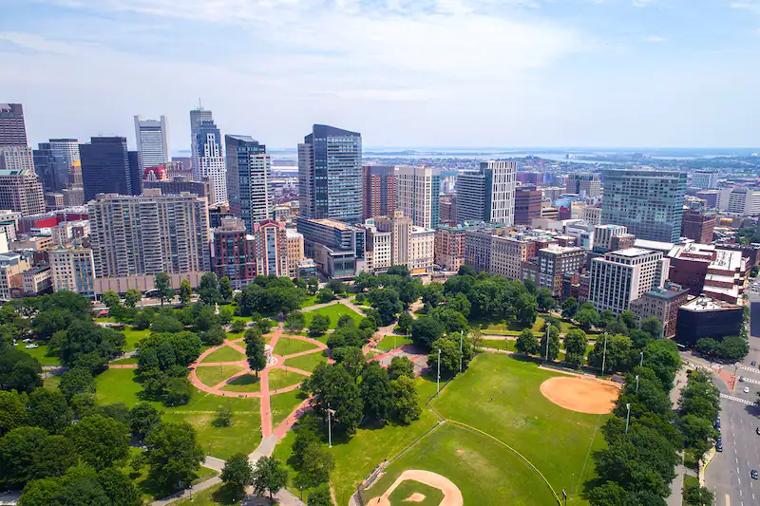
Gun Violence
Gun Violence - Team 3
Team Members:
Sarah Bonna (Team Lead),
Brian Mahabir,
Shivangi,
Showndarya Madhavan

Slide 2
Gun Violence
Project Motivation
Recent uptick in gun possession among youth in Boston's District 4
Need to understand the drivers of gun violence in the district and the city as a whole.
Inform policies that can improve the district and reduce the incidence of gun violence.

Slide 3
Gun Violence
Project Goal
To understand the drivers of gun violence in Boston's District 4 and the city as a whole, with a focus on identifying the variables associated with increases or decreases in gun violence.

Slide 4
Gun Violence
Project Background
To understand the project, it would be helpful to have knowledge of the factors that contribute to gun violence, such as poverty, access to firearms, mental health, and social dynamics.
Familiarity with the existing programs designed to address gun violence, their effectiveness, and their limitations would also be useful.

Slide 5
Gun Violence
Project Extension Proposal
Rationale:
To highlight potential important environmental trends which can pave the way for approvals for redesigning areas of Boston
Hypothesis:
Greener environments have less violence than desolate urban settings.
More gun violence incidents closer to community centers.

Slide 6
Progress so far
Datasets used/to be used
Gun Violence
City Council Dataset
Shots Fired
Shootings
Community Centers
Parks
Explored the Community Centers dataset
Focused on Community Centers dataset to create mappings to City Council Districts
No concrete analysis derived from parks dataset

Slide 7
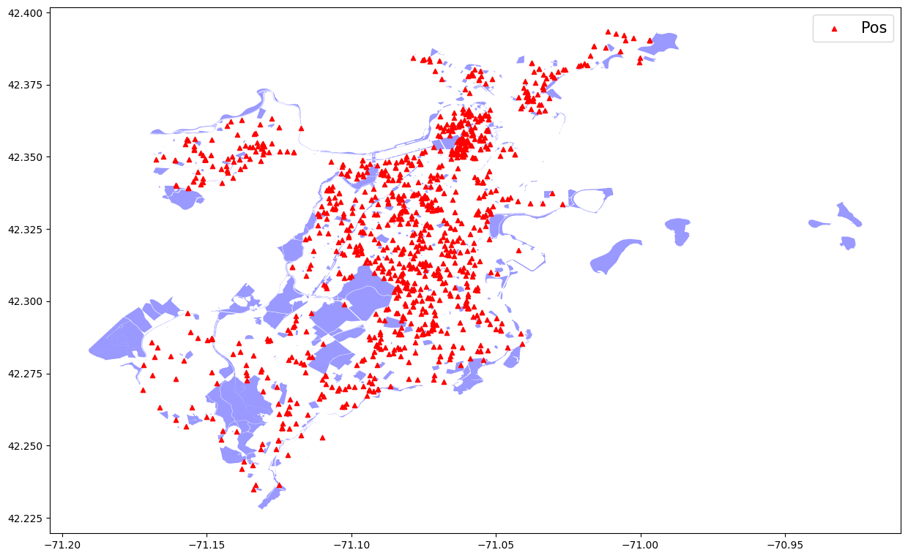
Parks Gun Violence Map
Key Findings:
Most gun violence does not happen in parks
Boston has a high park area ratio to city its hard to say if shootings happen near parks with this bias

Slide 8
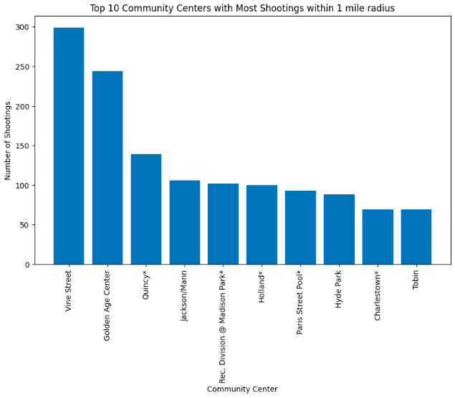
Top 10 Community Centers with Most Shootings
Key Findings:
More shootings near Community Centers seem to happen in City Council 1 and 7, with 3 Community Centers each in the top 10 list.
There are only one Community Centers from City Councils 4, 2, 9 and 5 in the top 10 list.

Slide 9
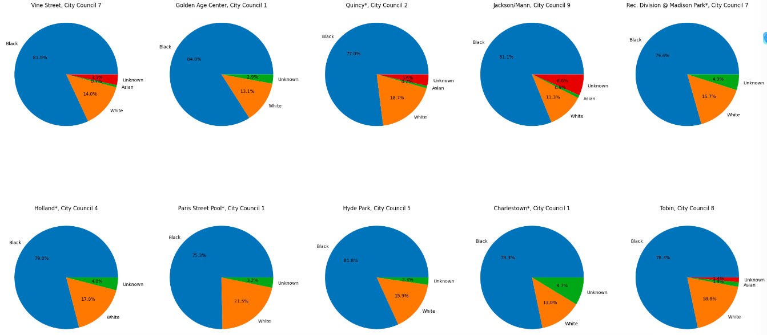
Race Segmentation for Community Centers

Slide 10
Race Segmentation for Community Centers Key Findings
Key Findings:
In every Community Center on the top 10 list, more than 75% of the victims are Black.
The Community Center at Holland (City Council 4) has the highest number of White and Asian victims out of the Community Centers in the top 10 list at 19.5% and 1.1 % respectively.

Slide 11
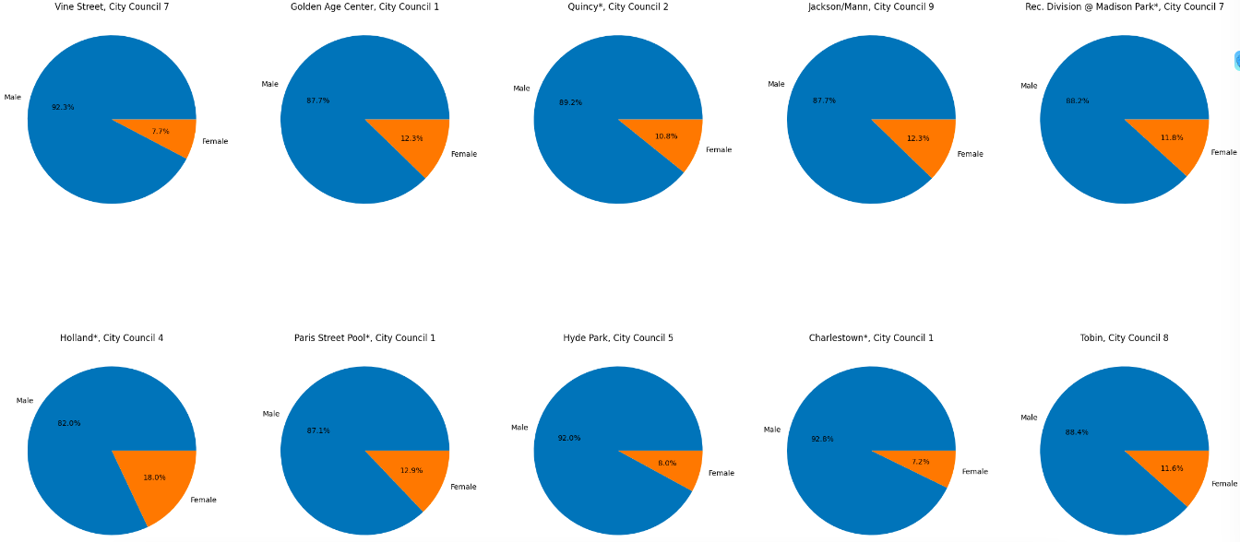
Gender Segmentation for Community Centers

Slide 12
Gender Segmentation for Community Centers Key Findings
Key Findings:
In all the Community Centers in the top 10 list, there are always more male victims than female victims (more than 80% of the victims are males in every case vs more than 7% for females).
Charlestown in City Council 1 has the highest percentage of male victims at 92.8%, whereas for females, it is at Holland in City Council 4, with 18%.

Slide 13
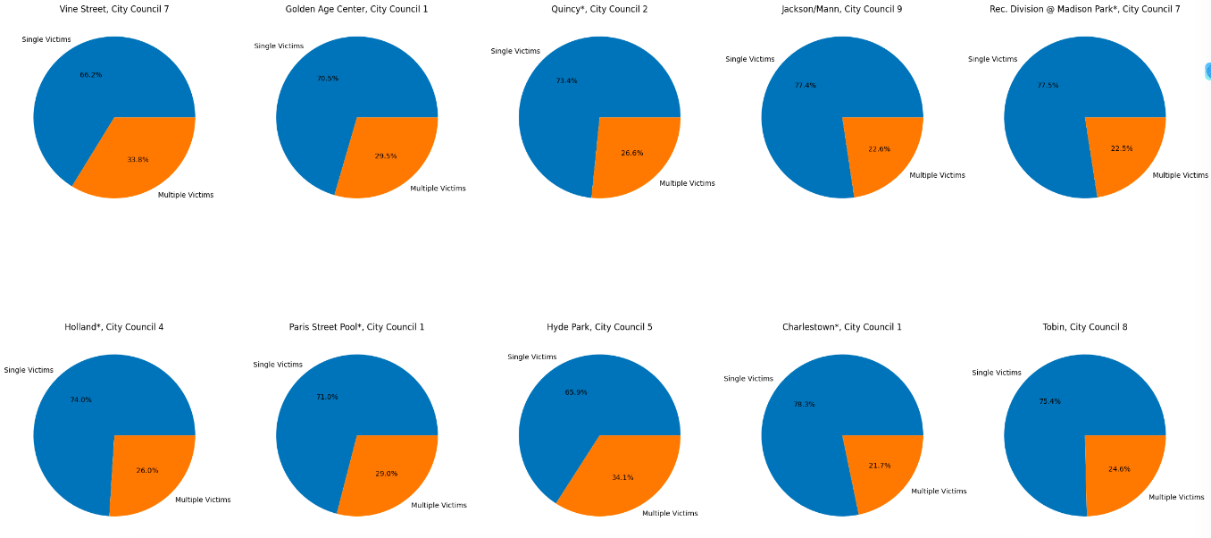
Single Victim vs Multiple Victims for Community Centers

Slide 14
Single Victim vs Multiple Victims for Community Centers
Key Findings
Key Findings:
In all the Community Centers in the top 10 list, there are always more incidents with single victims than multiple victims (more than 60% of the incidents have a single victim in every case vs more than 21% for multiple victims).
Charlestown in City Council 1 has the highest percentage of incidents with a single victim at 78.3%, whereas for multiple victims, it is at Vine Street in City Council 7, with 33.8%.

Slide 15
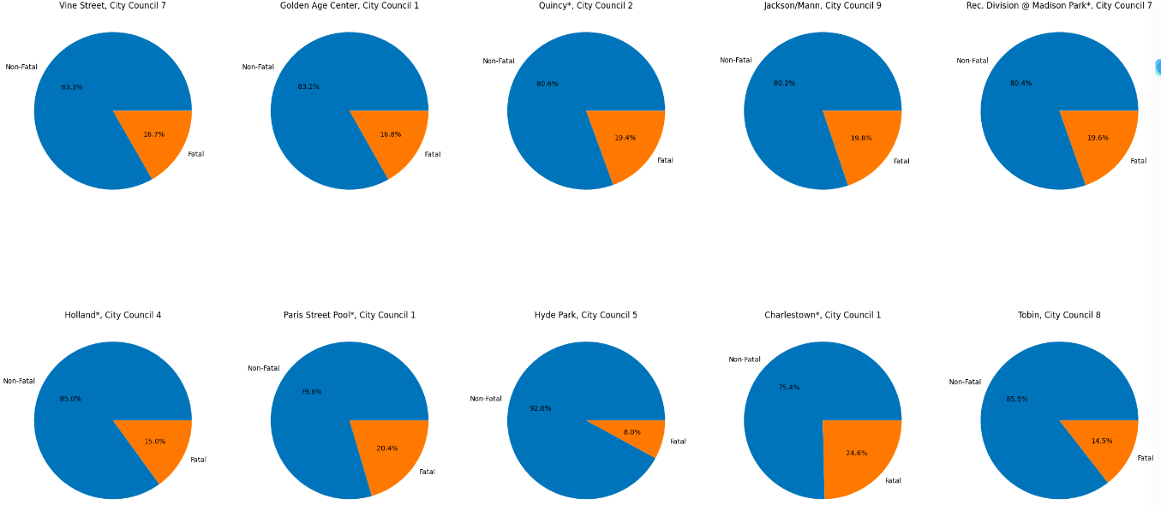
Fatal vs Nonfatal Shootings for Community Centers

Slide 16
Fatal vs Nonfatal Shootings for Community Centers Key Findings
Key Findings:
In all the Community Centers in the top 10 list, there are always more non-fatal than fatal incidents (more than 75% of the incidents are non-fatal in every case vs more than 14% for fatal ones).
Hyde Park in City Council 5 has the highest percentage of male victims at 92%, whereas for fatal ones, it is at Charlestown in City Council 1, with 24.6%.

Slide 17
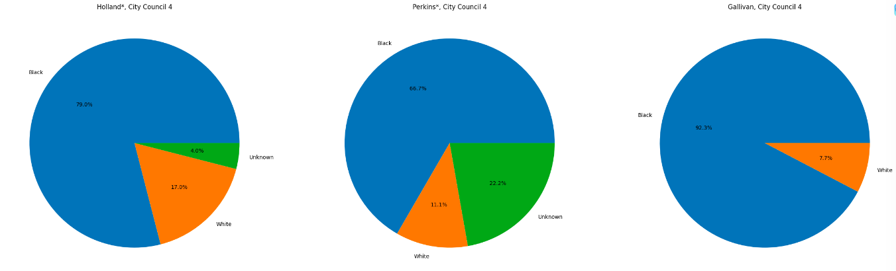
Race Segmentation for D4 Community Centers

Slide 18
Race Segmentation for D4 Community Centers Key Findings
Key Findings
For the top 3 community centers in D4 We see that the majority race that is affected are black
White and the rest of unknown races combined at most have 1/3 the amount of gun violence incidents while the rest is black
These community centers are located in predominantly black neighborhoods so our graphs represent those biases

Slide 19
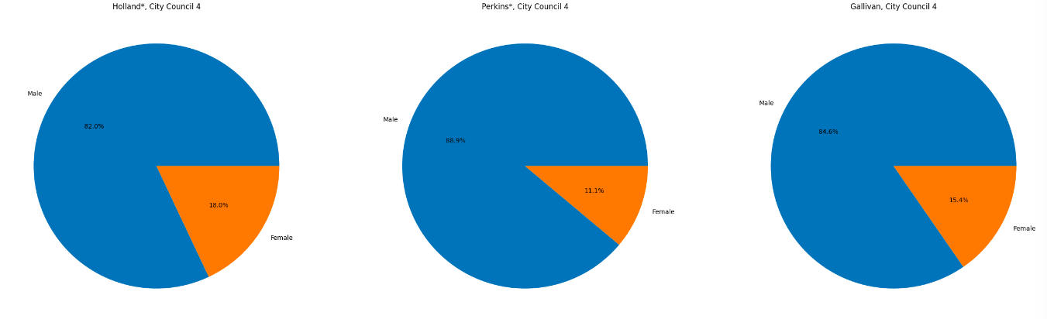
Gender Segmentation for D4 Community Centers

Slide 20
Gender Segmentation for D4 Community Centers Key Findings
Key Findings
For the top 3 community centers in D4 We see that male victims outnumber female victims by 4 to 1.
Generally, it's considered that men perpetrate more gun violence than women (due to sociological properties) so seeing men victims also high is interesting

Slide 21
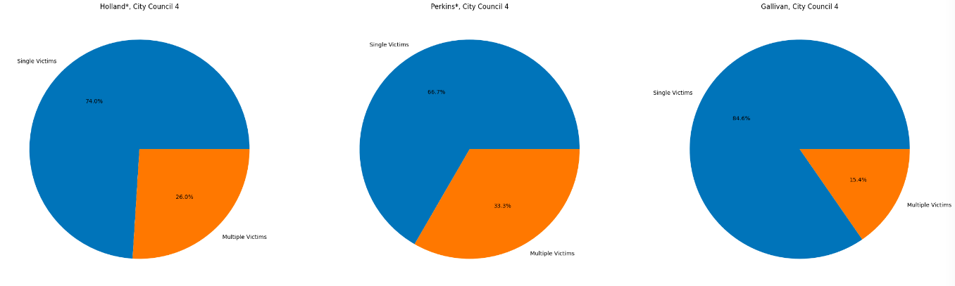
Single vs Multiple Victims for D4 Community Centers

Slide 22
Single vs Multiple Victims for D4 Community Centers Key Findings
Key Findings
For the top 3 community centers in D4 Single Victims outnumber Multiple Victims almost 4 to 1
Community centers are a public place with lots of people so its interesting that multiple victims are less than single. This could highlight a bias in our data where we get a range of incidents near the community center within one mile

Slide 23
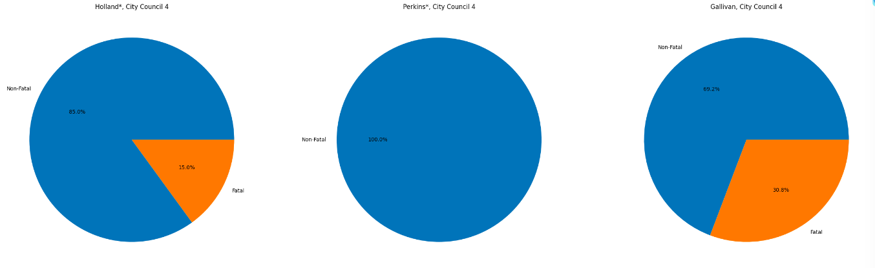
Fatal vs Nonfatal Shootings for D4 Community Centers

Slide 24
Fatal vs Nonfatal Shootings for D4 Community Centers Key Findings
Key Findings
For the top 3 community centers in D4 Non fatal incidents happen on average 85% and fatal incidents happen 15%
On average most shootings have more non-fatal vs fatal but its still interesting to note the same trend happening on a local level

Slide 25
Next steps
Questions/Obstacles
Wrap up the report and final analysis.
We ain't got none for now!

Slide 26
Questions?
Gun Violence

